Slide 1
Belief Function Basics
Data Fusion Leveraging Dempster-Shafer Theory
Dan Harris
Daniel.harris2@ngc.com
10 January 2023

Slide 2
Topics & Objectives
Topics:
Motivation & Overview
Definitions
Transformations
Pre-Fusion Processing
Data Fusion
Post-Fusion Processing
References
Objectives:
Gain a working knowledge of how the most common form of information (a predictive probability) relates to the Dempster-Shafer belief function framework
Gain a working knowledge of how to apply advanced pre-fusion processing techniques to improve the fusion results.
Gain the essential conceptual understanding required to build a tensor fusion system that leverages Dempster-Shafer Theory.

Slide 3
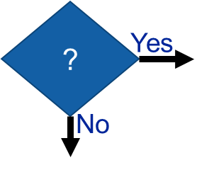
Motivation & Overview
Observe
Orient
Decide
Act
Credal Level
Pignisitic Level
Perceptual Level
Existential Level
Collect evidence
Make sense of evidence
Use evidence
Cause of evidence
Suppose we needed to act or react to a situation… what goes into making an action in real life for rational actors?
Say you’ve developed symptoms of being sick… or a missile lunched from a rouge nation.
According to Smets, information can be represented at what might be considered two fundamentally different levels [1–4]:
The credal level where beliefs are entertained
The pignistic level where decisions are made
Belief
?
Yes
No
Our focus today
Can any of this be automated? Is there any benefit to automating it?

Slide 4
Definitions
Transformations
Pre-Fusion Processing
Data Fusion
Post-Fusion Processing
Definitions:
Frame of Discernment (FoD)
Power Set
Basic Belief Assignment
Basic Belief Mass
Focal
Committed, Uncommitted, and Vacuous Belief
Cardinality
Plausibility and Contour Functions
Conjunctive Rule of Combination
Conflict
Agreement
Root Propositions

Slide 5

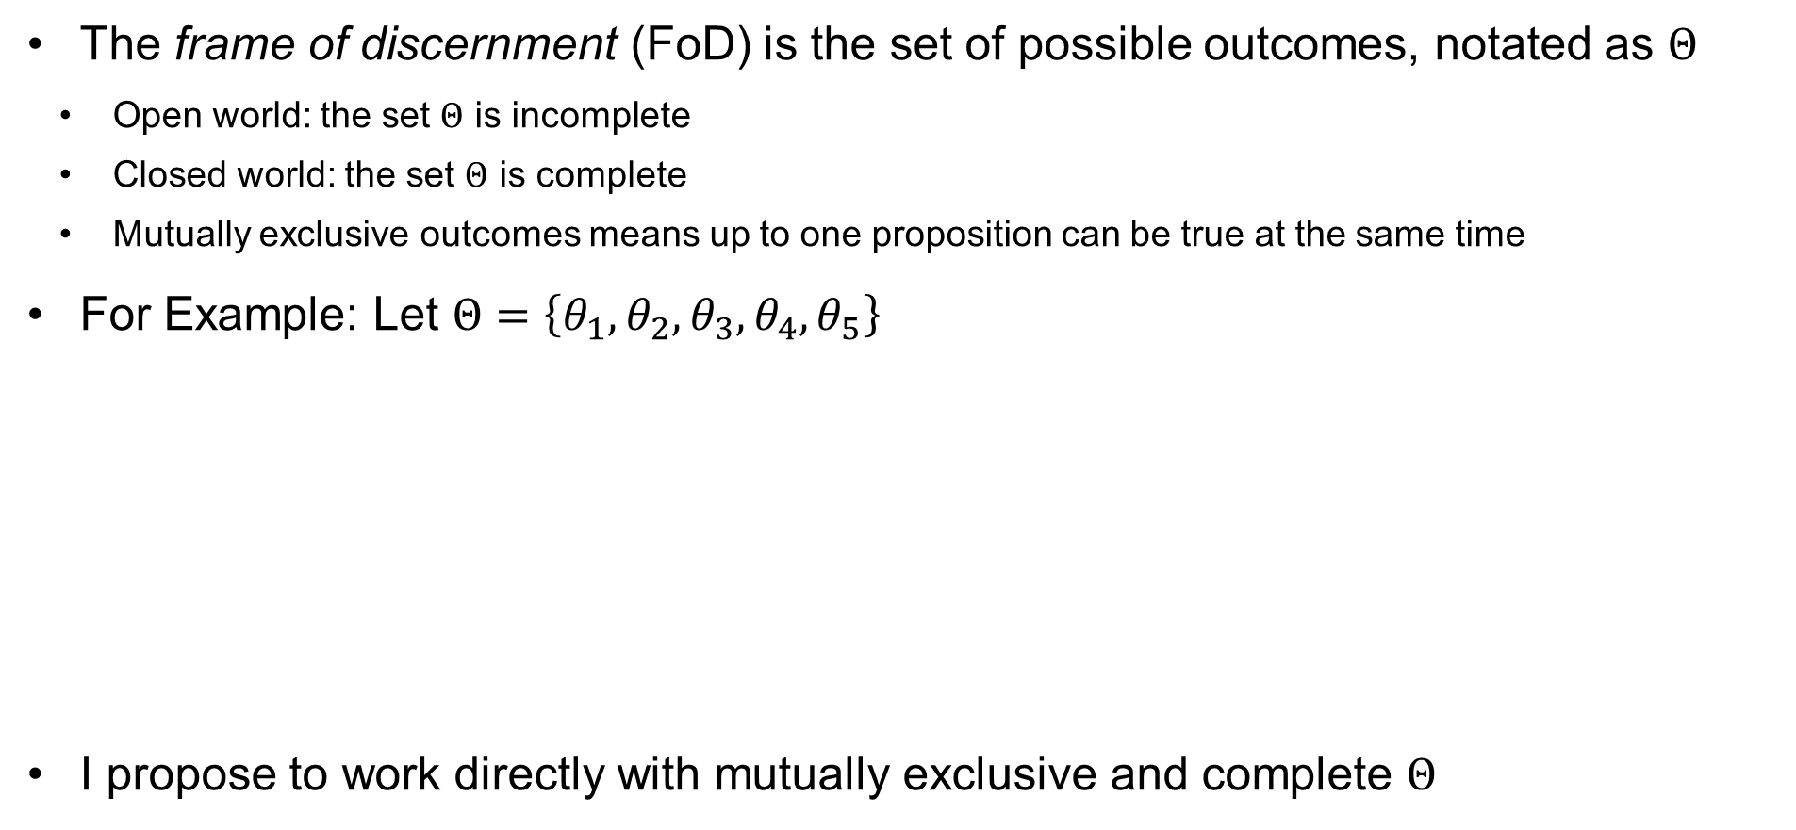




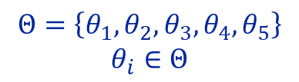
Definitions: Frame of Discernment
The frame of discernment (FoD) is the set of possible outcomes, notated as $Θ$
  Open world: the set $Θ$ is incomplete
  Closed world: the set $Θ$ is complete
  Mutually exclusive outcomes means up to one proposition can be true at the same time
For Example: Let $Θ=\left\{θ_{1},θ_{2},θ_{3},θ_{4},θ_{5}\right\}$
I propose to work directly with mutually exclusive and complete $Θ$
Closed World &
Mutually Exclusive
Open World &
Not Mutually Exclusive
$$Θ=\left\{θ_{1},θ_{2},θ_{3},θ_{4},θ_{5}\right\}$$
$$θ_{i}∈Θ$$
$$θ_{4}$$
$$θ_{1}$$
$$θ_{5}$$
𝜃_5
$$θ_{1}$$
𝜃_1
$$θ_{2}$$
𝜃_2
$$θ_{3}$$
𝜃_3
$$θ_{4}$$
𝜃_4
$$θ_{5}$$
$$θ_{3}$$
$$θ_{2}$$
Notes:
From the medical example earlier, someone give me an example of an open world set of non-mutually exclusive diseases that might explain some notional symptoms.
From the missile defense example, someone give me a set of target classifications that is closed world and mutually exclusive. Who’s our friend in deriving such sets… law of excluded middle. A or non-A; or if more options, A, B, or other.

Slide 6
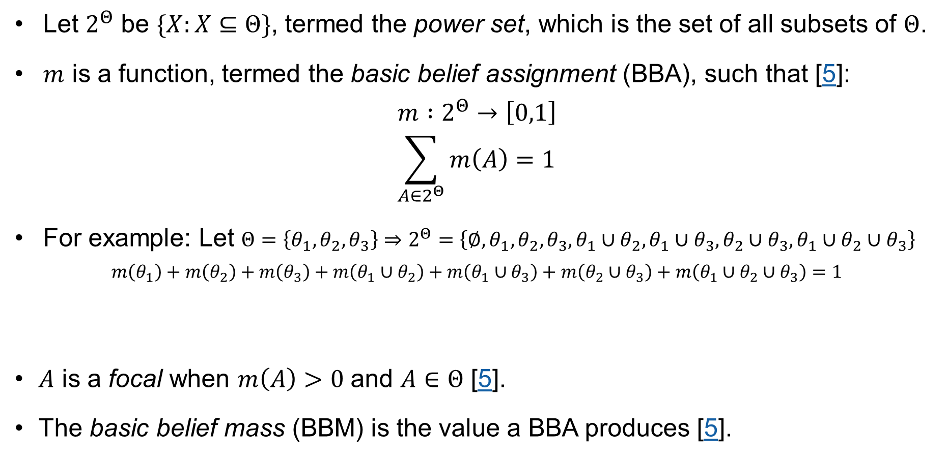
Definitions: Basic Belief Assignment
Let $2^{Θ}$ be $\{X:X⊆Θ\}$, termed the power set, which is the set of all subsets of $Θ$.
$m$ is a function, termed the basic belief assignment (BBA), such that [5]:
$$m :2^{Θ}→\left[0,1\right] \\ \sum_{A∈2^{Θ}}{m\left(A\right)=1}$$
For example: Let $Θ=\left\{θ_{1},θ_{2},θ_{3}\right\}⇒2^{Θ}=\left\{∅,θ_{1},θ_{2},θ_{3},θ_{1}∪θ_{2},θ_{1}∪θ_{3},θ_{2}∪θ_{3},θ_{1}∪θ_{2}∪θ_{3}\right\}$
$$m\left(θ_{1}\right)+m\left(θ_{2}\right)+m\left(θ_{3}\right)+m\left(θ_{1}∪θ_{2}\right)+m\left(θ_{1}∪θ_{3}\right)+m\left(θ_{2}∪θ_{3}\right)+m\left(θ_{1}∪θ_{2}∪θ_{3}\right)=1$$
$A$ is a focal when $m\left(A\right)>0$ and $A∈Θ$ [5].
The basic belief mass (BBM) is the value a BBA produces [5].
Committed Belief
Uncommitted Belief
Between 2 options
Vacuous Belief

Slide 7

Definitions: Cardinality
The number of elements in a focal is termed cardinality, notated with $\left|∙\right|$.
$$\left|∙\right| :2^{Θ}→ℤ$$
For example:
  $A=θ_{1}∪θ_{2}∪θ_{3}⇒\left|A\right|=3$
  $A=θ_{1}∪θ_{3}⇒\left|A\right|=2$
  $A=θ_{1}⇒\left|A\right|=1$

Slide 8
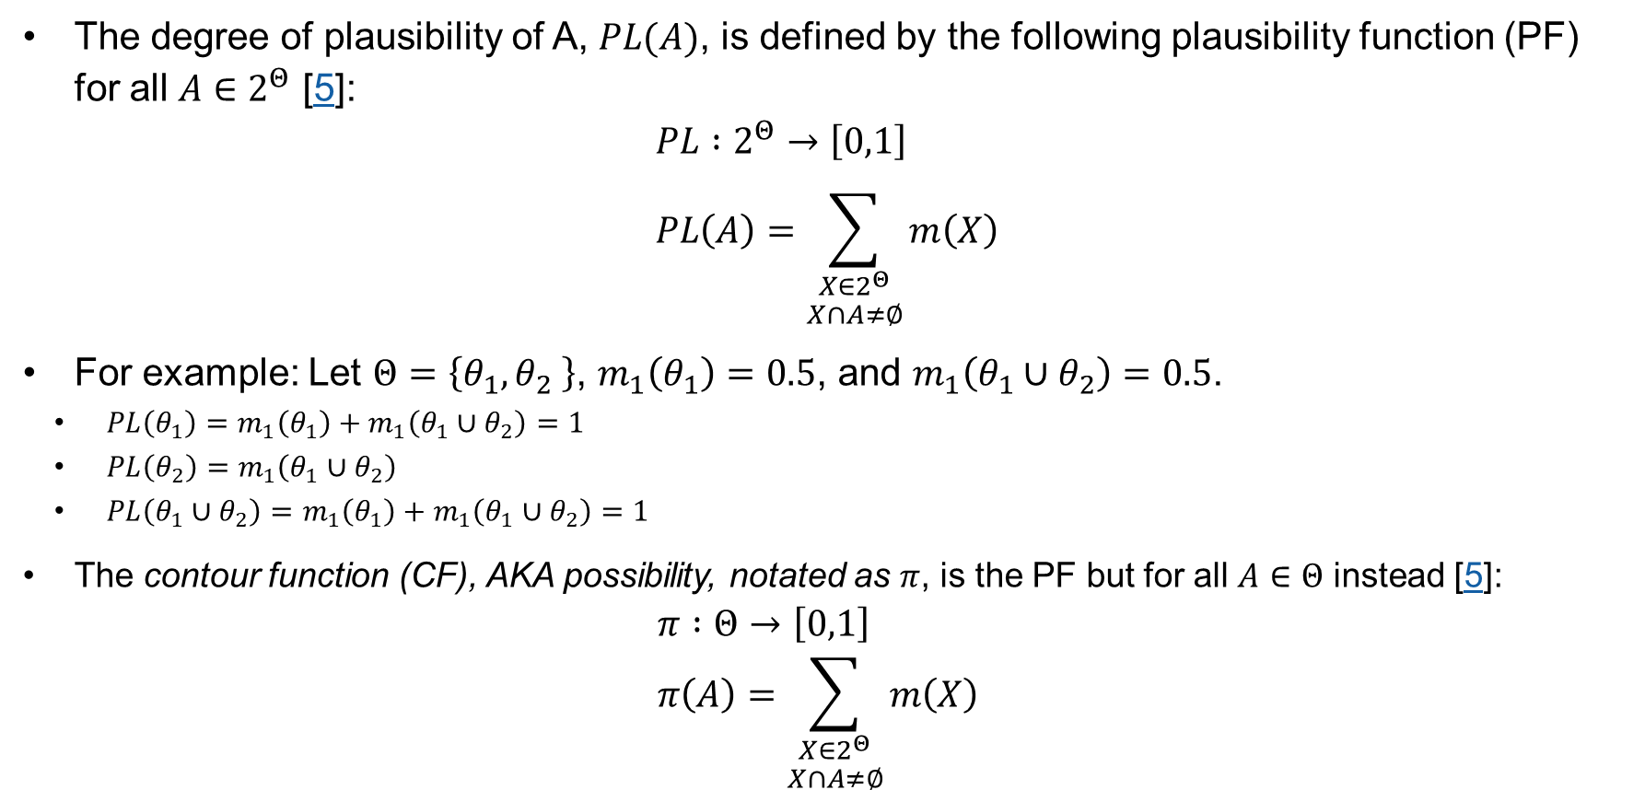
Definitions: Plausibility & Contour Functions
The degree of plausibility of A, $PL(A)$, is defined by the following plausibility function (PF) for all $A∈2^{Θ}$ [5]:
$$PL :2^{Θ}→\left[0,1\right] \\ PL\left(A\right)=\sum_{\begin{aligned}X∈2^{Θ} \\ X∩A≠∅\end{aligned}}{m\left(X\right)}$$
For example: Let $Θ=\left\{θ_{1},θ_{2} \right\}$, $m_{1}\left(θ_{1}\right)=0.5$, and $m_{1}\left(θ_{1}∪θ_{2}\right)=0.5$.
  $PL\left(θ_{1}\right)=m_{1}\left(θ_{1}\right)+m_{1}\left(θ_{1}∪θ_{2}\right)=1$
  $PL\left(θ_{2}\right)=m_{1}\left(θ_{1}∪θ_{2}\right)$
  $PL\left(θ_{1}∪θ_{2}\right)=m_{1}\left(θ_{1}\right)+m_{1}\left(θ_{1}∪θ_{2}\right)=1$
The contour function (CF), AKA possibility, notated as $π$, is the PF but for all $A∈Θ$ instead [5]:
  $$π :Θ→\left[0,1\right] \\ π\left(A\right)=\sum_{\begin{aligned}X∈2^{Θ} \\ X∩A≠∅\end{aligned}}{m\left(X\right)}$$

Slide 9








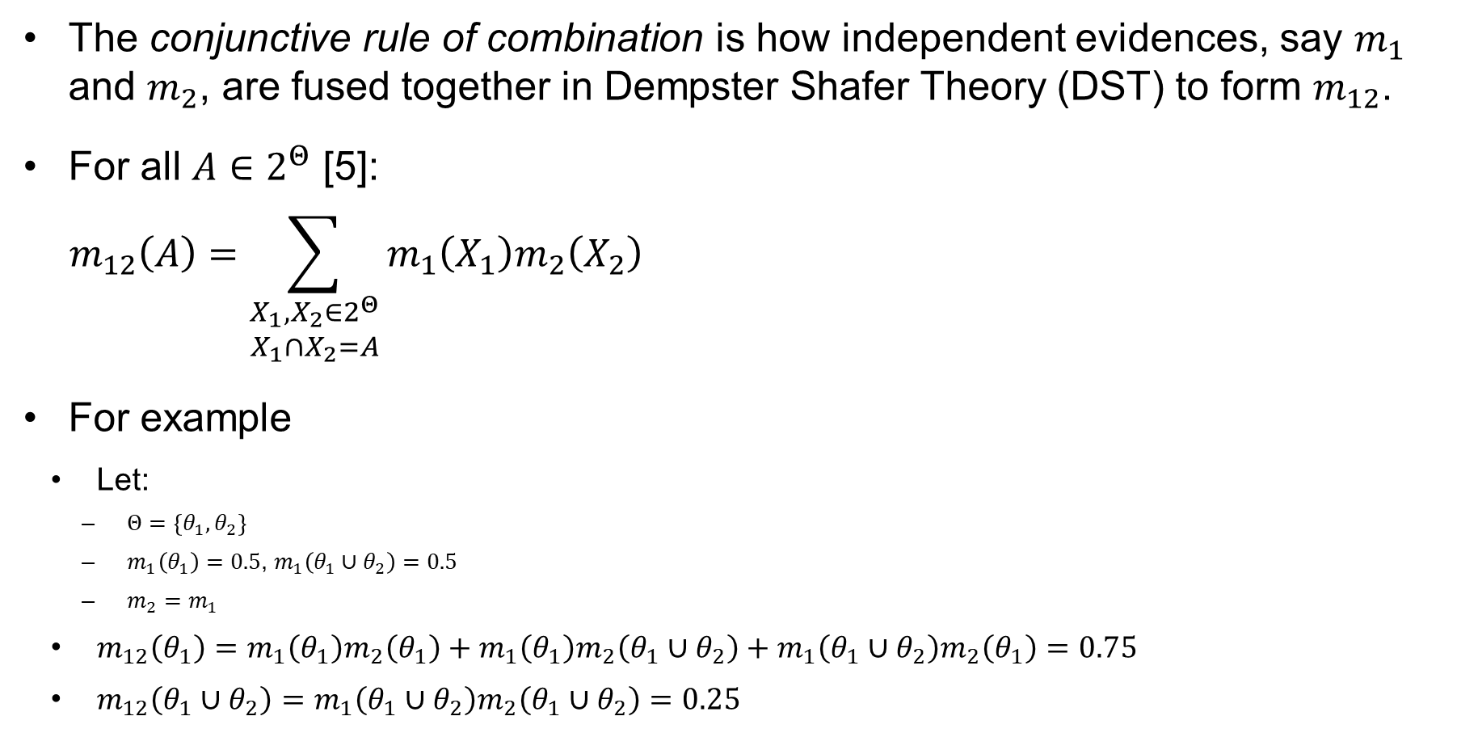


Definitions: Conjunctive Rule of Combination
The conjunctive rule of combination is how independent evidences, say $m_{1}$ and $m_{2}$, are fused together in Dempster Shafer Theory (DST) to form $m_{12}$.
For all $A∈2^{Θ}$ [5]:
$$m_{12}\left(A\right)=\sum_{\begin{matrix}X_{1},X_{2}∈2^{Θ} \\ X_{1}∩X_{2}=A\end{matrix}}{m_{1}\left(X_{1}\right)m_{2}\left(X_{2}\right)}$$
For example
  Let:
    $Θ=\left\{θ_{1},θ_{2}\right\}$
    $m_{1}\left(θ_{1}\right)=0.5$, $m_{1}\left(θ_{1}∪θ_{2}\right)=0.5$
    $m_{2}=m_{1}$
  $m_{12}\left(θ_{1}\right)=m_{1}\left(θ_{1}\right)m_{2}\left(θ_{1}\right)+m_{1}\left(θ_{1}\right)m_{2}\left(θ_{1}∪θ_{2}\right)+m_{1}\left(θ_{1}∪θ_{2}\right)m_{2}\left(θ_{1}\right)=0.75$
  $m_{12}\left(θ_{1}∪θ_{2}\right)=m_{1}\left(θ_{1}∪θ_{2}\right)m_{2}\left(θ_{1}∪θ_{2}\right)=0.25$
Matrix Representation
$$m_{1}\left(θ_{1}\right)$$
$$m_{1}\left(θ_{1}∪θ_{2}\right)$$
$$m_{1}$$
$$m_{1}\left(θ_{1}\right)m_{2}\left(θ_{1}\right)$$
$$θ_{1}∩θ_{1}$$
$$m_{1}\left(θ_{1}∪θ_{2}\right)m_{2}\left(θ_{1}\right)$$
$$\left(θ_{1}∪θ_{2}\right)∩θ_{1}$$
$$m_{2}\left(θ_{1}\right)$$
$$m_{1}\left(θ_{1}\right)m_{2}\left(θ_{1}∪θ_{2}\right)$$
$$θ_{1}∩\left(θ_{1}∪θ_{2}\right)$$
$$m_{1}\left(θ_{1}∪θ_{2}\right)m_{2}\left(θ_{1}∪θ_{2}\right)$$
$$\left(θ_{1}∪θ_{2}\right)∩\left(θ_{1}∪θ_{2}\right)$$
$$m_{2}\left(θ_{1}∪θ_{2}\right)$$
$$m_{2}$$

Slide 10
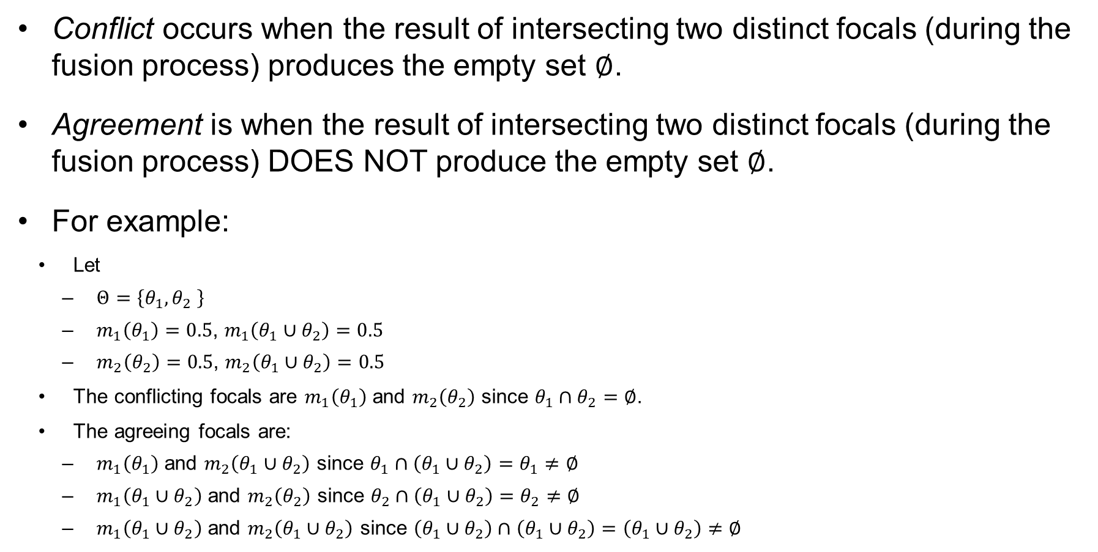
Definitions: Conflict and Agreement
Conflict occurs when the result of intersecting two distinct focals (during the fusion process) produces the empty set $∅$.
Agreement is when the result of intersecting two distinct focals (during the fusion process) DOES NOT produce the empty set $∅$.
For example:
  Let
    $Θ=\left\{θ_{1},θ_{2} \right\}$
    $m_{1}\left(θ_{1}\right)=0.5$, $m_{1}\left(θ_{1}∪θ_{2}\right)=0.5$
    $m_{2}\left(θ_{2}\right)=0.5\text{, }m_{2}\left(θ_{1}∪θ_{2}\right)=0.5$
  The conflicting focals are $m_{1}\left(θ_{1}\right)$ and $m_{2}\left(θ_{2}\right)$ since $θ_{1}∩θ_{2}=∅$.
  The agreeing focals are:
    $m_{1}\left(θ_{1}\right)$ and $m_{2}\left(θ_{1}∪θ_{2}\right)$ since $θ_{1}∩\left(θ_{1}∪θ_{2}\right)=θ_{1}≠∅$
    $m_{1}\left(θ_{1}∪θ_{2}\right)$ and $m_{2}\left(θ_{2}\right)$ since $θ_{2}∩\left(θ_{1}∪θ_{2}\right)=θ_{2}≠∅$
    $m_{1}\left(θ_{1}∪θ_{2}\right)$ and $m_{2}\left(θ_{1}∪θ_{2}\right)$ since $\left(θ_{1}∪θ_{2}\right)∩\left(θ_{1}∪θ_{2}\right)=\left(θ_{1}∪θ_{2}\right)≠∅$

Slide 11
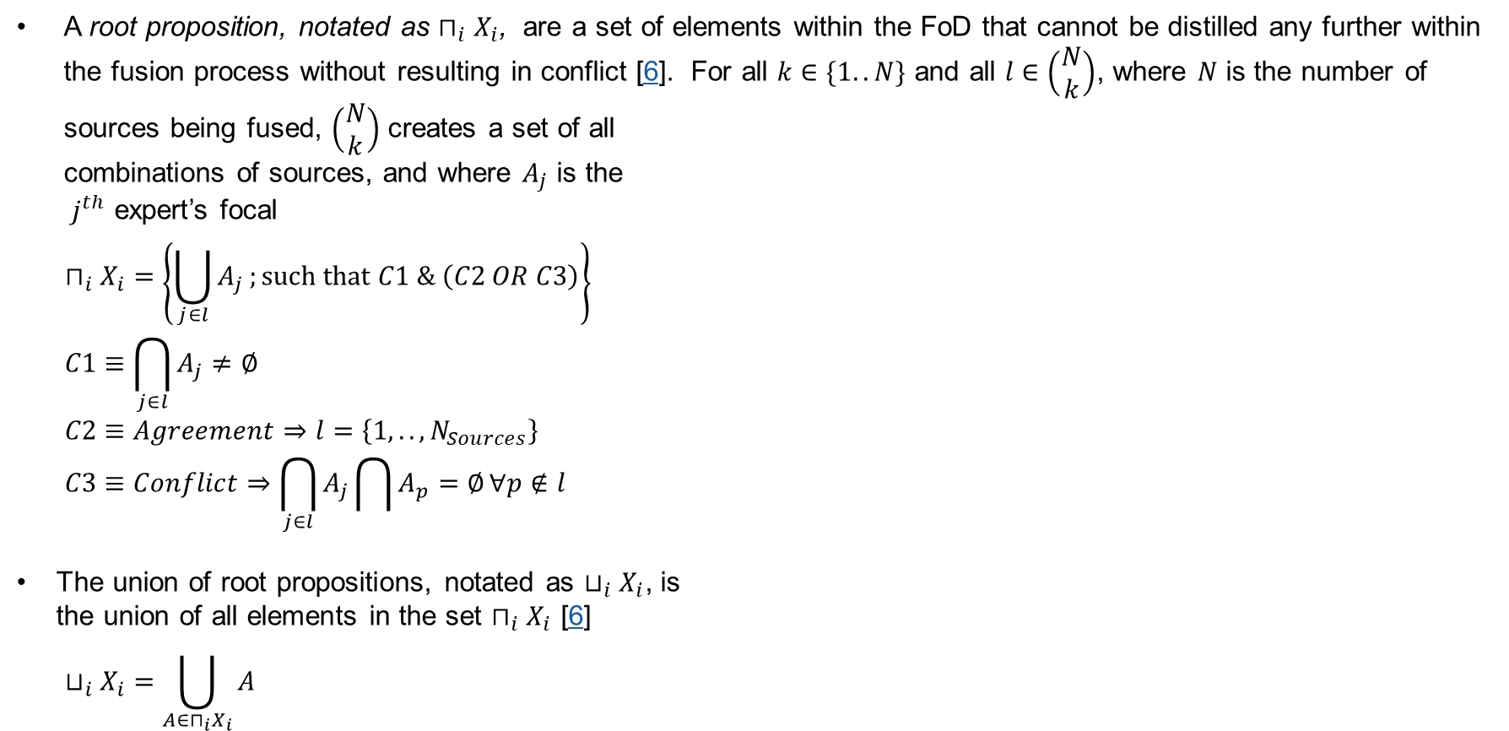
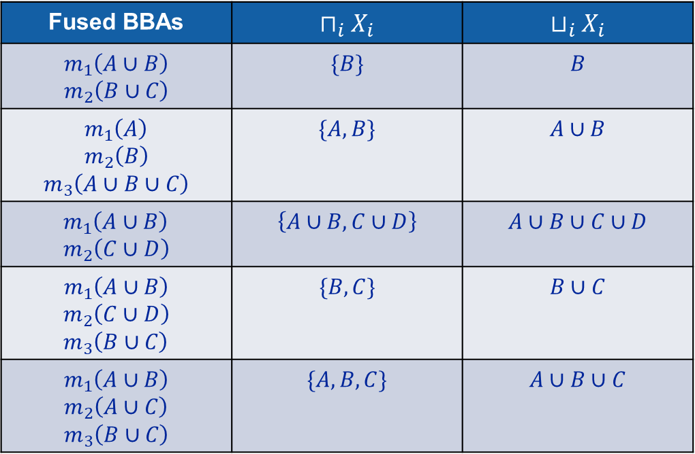
Definitions: Root Propositions
A root proposition, notated as $⊓_{i}X_{i}$, are a set of elements within the FoD that cannot be distilled any further within the fusion process without resulting in conflict [6]. For all $k∈\{1..N\}$ and all $l∈\left(\begin{matrix}N \\ k\end{matrix}\right)$, where $N$ is the number of sources being fused, $\left(\begin{matrix}N \\ k\end{matrix}\right)$ creates a set of all
combinations of sources, and where $A_{j}$ is the
$j^{th}$ expert’s focal
$$⊓_{i}X_{i}=\left\{\bigcup_{j∈l}{A_{j}};such that C1 \& \left(C2 OR C3\right)\right\} \\ C1≡\bigcap_{j∈l}{A_{j}≠∅} \\ C2≡Agreement⇒l=\left\{1,..,N_{Sources}\right\} \\ C3≡Conflict⇒\bigcap_{j∈l}{A_{j}}\bigcap{A_{p}=∅}∀p∉l$$
The union of root propositions, notated as $⊔_{i}X_{i}$, is
the union of all elements in the set $⊓_{i}X_{i}$ [6]
$$⊔_{i}X_{i}=\bigcup_{A∈⊓_{i}X_{i}}{A}$$
Fused BBAs | $$⊓_{i}X_{i}$$ | $$⊔_{i}X_{i}$$
$$m_{1}\left(A∪B\right) \\ m_{2}\left(B∪C\right)$$ | $$\{B\}$$ | $$B$$
$$m_{1}\left(A\right) \\ m_{2}\left(B\right)$$ $$m_{3}\left(A∪B∪C\right)$$ | $$\{A,B\}$$ | $$A∪B$$
$$m_{1}\left(A∪B\right) \\ m_{2}\left(C∪D\right)$$ | $$\left\{A∪B,C∪D\right\}$$ | $$A∪B∪C∪D$$
$$m_{1}\left(A∪B\right)$$ $$m_{2}\left(C∪D\right) \\ m_{3}\left(B∪C\right)$$ | $$\{B,C\}$$ | $$B∪C$$
$$m_{1}\left(A∪B\right) \\ m_{2}\left(A∪C\right)$$ $$m_{3}\left(B∪C\right)$$ | $$\{A,B,C\}$$ | $$A∪B∪C$$

Slide 12
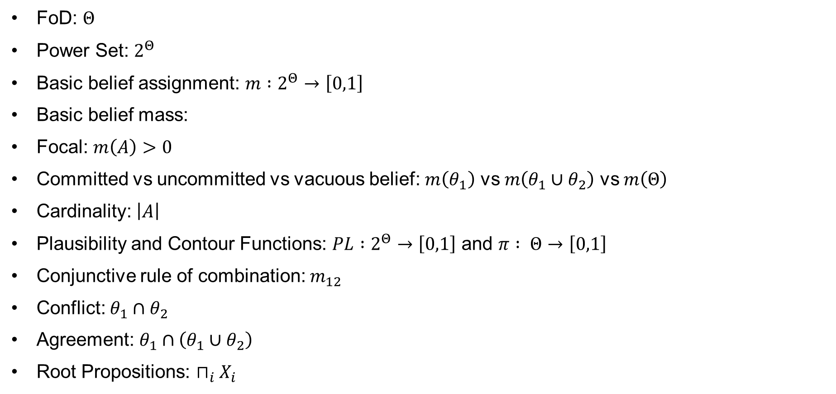
Definitions: Review
FoD: $Θ$
Power Set: $2^{Θ}$
Basic belief assignment: $m :2^{Θ}→\left[0,1\right]$
Basic belief mass:
Focal: $m\left(A\right)>0$
Committed vs uncommitted vs vacuous belief: $m\left(θ_{1}\right)$ vs $m\left(θ_{1}∪θ_{2}\right)$ vs $m\left(Θ\right)$
Cardinality: $\left|A\right|$
Plausibility and Contour Functions: $PL :2^{Θ}→\left[0,1\right]$ and $π : Θ→\left[0,1\right]$
Conjunctive rule of combination: $m_{12}$
Conflict: $θ_{1}∩θ_{2}$
Agreement: $θ_{1}∩\left(θ_{1}∪θ_{2}\right)$
Root Propositions: $⊓_{i}X_{i}$

Slide 13
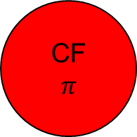

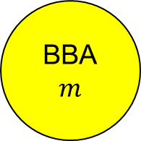
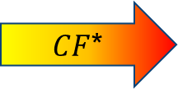
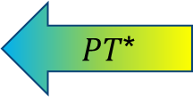
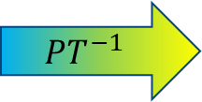
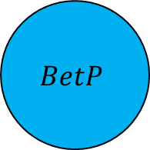
Definitions
Transformations
Pre-Fusion Processing
Data Fusion
Post-Fusion Processing
Transformations:
Pignistic Transform
Inverse Pignisitic Transform
Consonant Belief Function
$$BetP$$
$$PT^{−1}$$
BBA
$$m$$
$CF$*
CF
$$π$$
$PT$*
$$CBF$$
*Note: These transformations are lossy

Slide 14
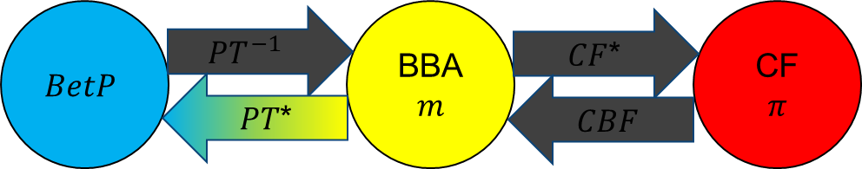
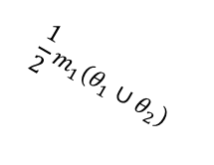
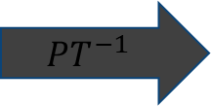

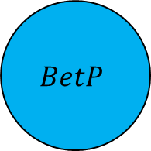

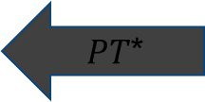



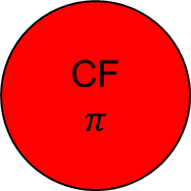


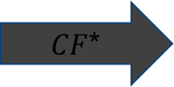


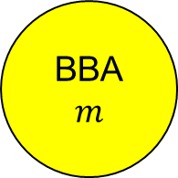


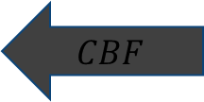
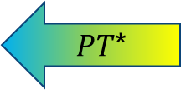

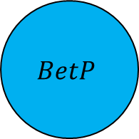
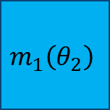
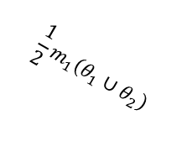
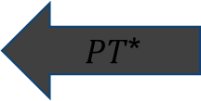



Transformations: Pignistic Transformation
Transforming credal information into pignistic information for all $A∈2^{Θ}$
$$BetP\left(A\right)=\sum_{X∈2^{Θ}}{\frac{\left|X∩A\right|}{\left|x\right|}m\left(X\right)}$$
For example:
  Let
    $Θ=\left\{θ_{1},θ_{2} \right\}$
    $m_{1}\left(θ_{2}\right)=0.5$, $m_{1}\left(θ_{1}∪θ_{2}\right)=0.5$
  $BetP^{Θ}=\left[0.25,0.75\right]$
$$BetP$$
$$PT^{−1}$$
BBA
$$m$$
CF
$$π$$
+
$CF$*
$$m_{1}\left(θ_{2}\right)$$
$PT$*
$$CBF$$
$$m_{1}\left(θ_{1}∪θ_{2}\right)$$
$$\frac{1}{2}m_{1}\left(θ_{1}∪θ_{2}\right)$$
Break Apart
$$\frac{1}{2}m_{1}\left(θ_{1}∪θ_{2}\right)$$
$$BetP$$
$$PT^{−1}$$
BBA
$$m$$
$CF$*
CF
$$π$$
$PT$*
$$CBF$$
$$BetP\left(θ_{1}\right)$$
$$BetP\left(θ_{2}\right)$$
$$BetP$$
$$PT^{−1}$$
BBA
$$m$$
$CF$*
CF
$$π$$
$PT$*
$$CBF$$
*Note: These transformations are lossy

Slide 15
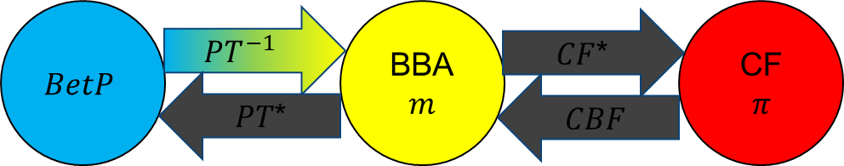






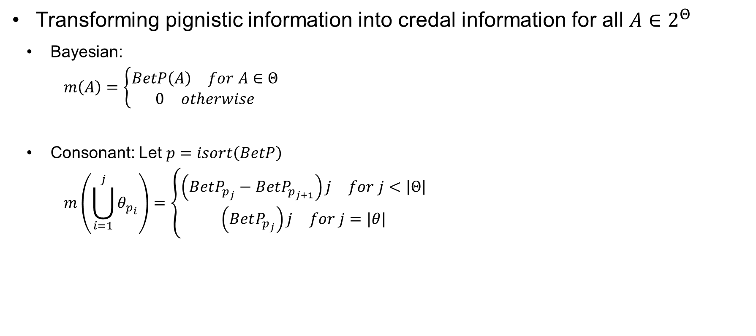








Transformations: Inverse Pignistic Transformation
Transforming pignistic information into credal information for all $A∈2^{Θ}$
  Bayesian:
  $$m\left(A\right)=\left\{\begin{aligned}\begin{matrix}BetP\left(A\right) & for A∈Θ\end{matrix} \\ \begin{matrix}0 & otherwise\end{matrix}\end{aligned}\right.$$
  Consonant: Let $p=isort\left(BetP\right)$
  $$m\left(\bigcup_{i=1}^{j}{θ_{p_{i}}}\right)=\left\{\begin{aligned}\begin{matrix}\left(BetP_{p_{j}}−BetP_{p_{j+1}}\right)j & for j<\left|Θ\right|\end{matrix} \\ \begin{matrix}\left(BetP_{p_{j}}\right)j & for j=|θ|\end{matrix}\end{aligned}\right.$$
Example: $BetP=[0.1 0.4 0.2 0.3]$
$$Θ=\left\{θ_{1},θ_{2},θ_{3},θ_{4}\right\}$$
$$a_{1}$$
$$m\left(θ_{p_{1}}\right)=a_{1}$$
$$a_{2}$$
$$m\left(θ_{p_{1}}∪θ_{p_{2}}\right)=2a_{2}$$
$$a_{3}$$
$$m\left(θ_{p_{1}}∪θ_{p_{2}}∪θ_{p_{3}}\right)=3a_{3}$$
$$a_{4}$$
$$m\left(Θ\right)=4a_{4}$$
$$BetP_{p_{1}}$$
$$BetP_{p_{2}}$$
$$BetP_{p_{3}}$$
$$BetP_{p_{4}}$$
*Note: These transformations are lossy

Slide 16
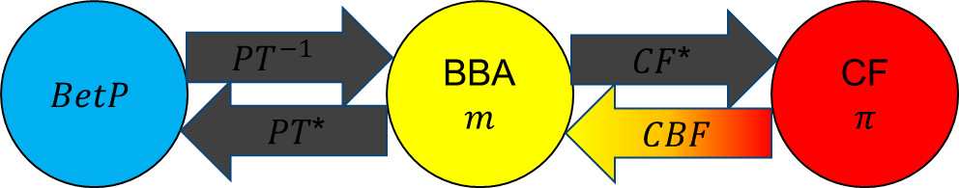











Transformations: Consonant Belief Function
Transforming contour functions, $π$, into credal information for all $A∈2^{Θ}$
  Let $p=isort\left(BetP\right)$
$$m\left(\bigcup_{i=1}^{j}{θ_{p_{i}}}\right)=\left\{\begin{aligned}\begin{matrix}π_{p_{j}}−π_{p_{j+1}} & for j<\left|Θ\right|\end{matrix} \\ \begin{matrix}1−π_{p_{1}}+π_{p_{j}} & for j=|θ|\end{matrix}\end{aligned}\right.$$
Example: $π=[0.5 0.1 1 1]$
$$1$$
$$Θ=\left\{θ_{1},θ_{2},θ_{3},θ_{4}\right\}$$
$$a_{0}$$
$$a_{1}$$
$$m\left(θ_{p_{1}}\right)=a_{1}$$
$$a_{2}$$
$$m\left(θ_{p_{1}}∪θ_{p_{2}}\right)=a_{2}$$
$$a_{3}$$
$$m\left(θ_{p_{1}}∪θ_{p_{2}}∪θ_{p_{3}}\right)=a_{3}$$
$$a_{4}$$
$$m\left(Θ\right)=a_{0}+a_{4}$$
$$π_{p_{1}}$$
$$π_{p_{2}}$$
$$π_{p_{3}}$$
$$π_{p_{4}}$$
*Note: These transformations are lossy

Slide 17
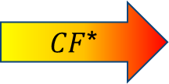

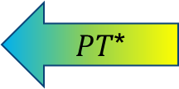
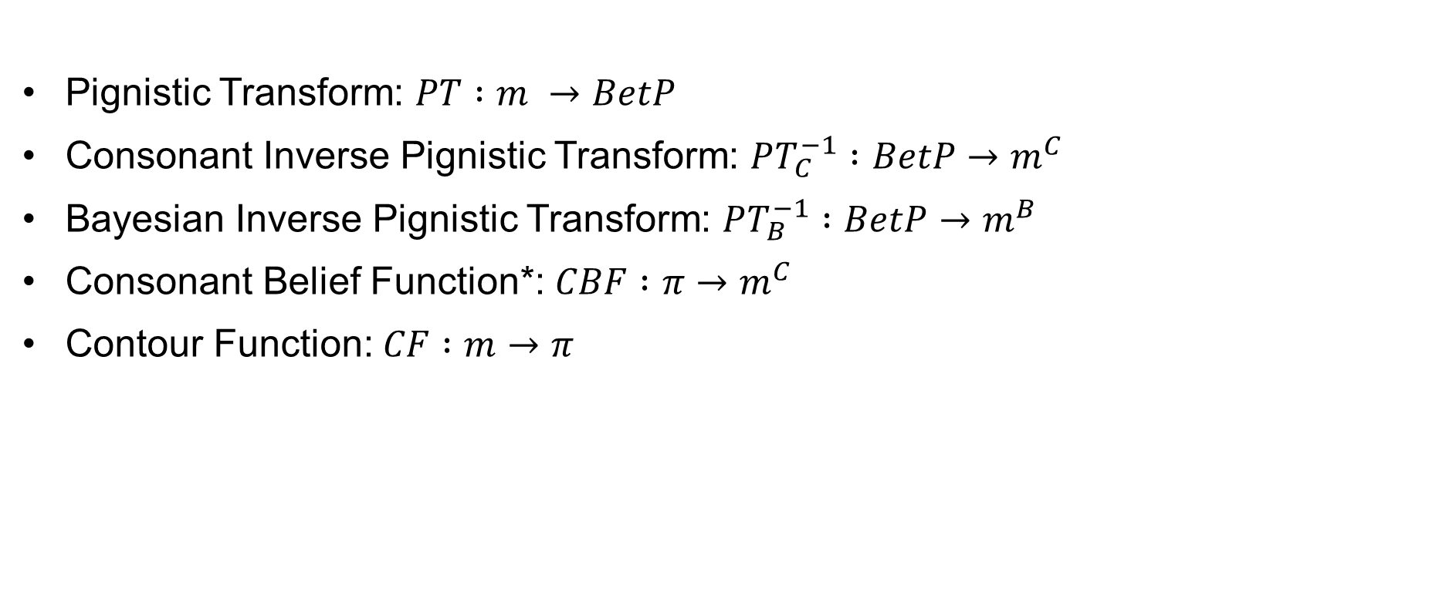




Transformations: Review
Pignistic Transform: $PT :m →BetP$
Consonant Inverse Pignistic Transform: $PT_{C}^{−1} :BetP→m^{C}$
Bayesian Inverse Pignistic Transform: $PT_{B}^{−1} :BetP→m^{B}$
Consonant Belief Function*: $CBF :π→m^{C}$
Contour Function: $CF :m→π$
$$BetP$$
$$PT^{−1}$$
BBA
$$m$$
$CF$*
CF
$$π$$
$PT$*
$$CBF$$
*Note: These transformations are lossy

Slide 18
Definitions
Transformations
Pre-Fusion Processing
Data Fusion
Post-Fusion Processing
Pre-Fusion Processing:
Removing Priors
FoD Alignment
Probability Calibration

Slide 19

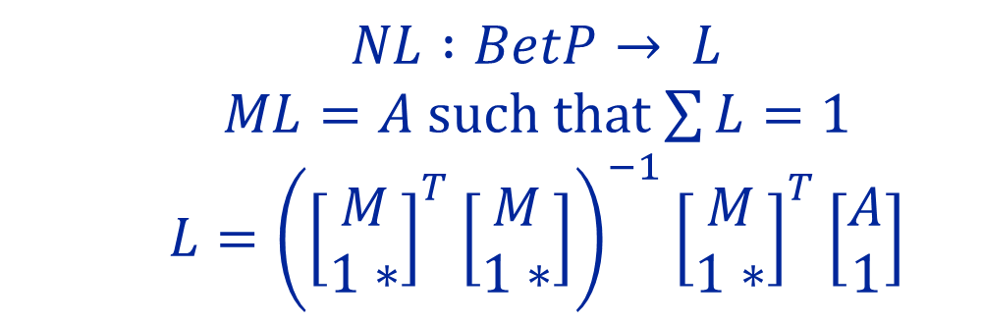
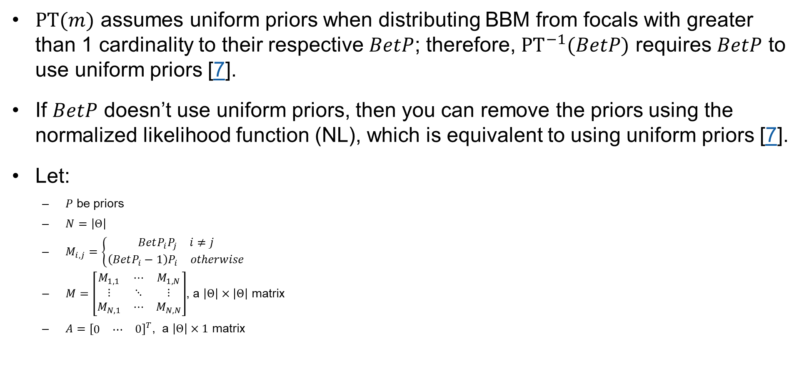
Pre-Fusion Processing: Remove Priors
$PT(m)$ assumes uniform priors when distributing BBM from focals with greater than 1 cardinality to their respective $BetP$; therefore, ${PT}^{−1}(BetP)$ requires $BetP$ to use uniform priors [7].
If $BetP$ doesn’t use uniform priors, then you can remove the priors using the normalized likelihood function (NL), which is equivalent to using uniform priors [7].
Let:
    $P$ be priors
    $N=\left|Θ\right|$
    $M_{i,j}=\left\{\begin{aligned}\begin{matrix}BetP_{i}P_{j} & i≠j\end{matrix} \\ \begin{matrix}\left(BetP_{i}−1\right)P_{i} & otherwise\end{matrix}\end{aligned}\right.$
    $M=\left[\begin{matrix}M_{1,1} & ⋯ & M_{1,N} \\ ⋮ & ⋱ & ⋮ \\ M_{N,1} & ⋯ & M_{N,N}\end{matrix}\right]$, a $\left|Θ\right|×\left|Θ\right|$ matrix
    $A={\left[\begin{matrix}\begin{matrix}0 & ⋯\end{matrix} & 0\end{matrix}\right]}^{T}$, a $\left|Θ\right|×1$ matrix
$$NL :BetP→ L$$
$ML=A$ such that $\sum{L}=1$
$$L={\left({\left[\begin{matrix}M \\ 1∗\end{matrix}\right]}^{T}\left[\begin{matrix}M \\ 1∗\end{matrix}\right]\right)}^{−1}{\left[\begin{matrix}M \\ 1∗\end{matrix}\right]}^{T}\left[\begin{matrix}A \\ 1\end{matrix}\right]$$
Example:
$$\text{BetP}\text{ = [0.0302 0.4683 0.4401 0.0614];}$$
$$\text{Prior}\text{ = [0.0498 0.6375 0.2211 0.0916];} \\ L= ?$$
Notes:
BetP = [0.0302 0.4683 0.4401 0.0614];
Prior = [0.0498 0.6375 0.2211 0.0916];
L = [0.1516 0.1835 0.4975 0.1675];
MATLAB:
% Set up problem
iseed = 256;
rng(iseed);
prior = rand(4,1);
prior = prior/sum(prior);
BetP = rand(4,1);
BetP = BetP/sum(BetP);
M = zeros(4,4);
for i = 1 : 4
for j = 1 : 4
if i == j
M(i,i) = (BetP(i)-1)*prior(i);
else
M(i,j) = BetP(i)*prior(j);
end
end
end
% Solve system of equations M*L=A such that sum(L) = 1 and i \in L >0 & < 1
C = [M;ones(1,4)];
A = zeros(4,1);
L = inv(C'*C)*C'*[A;1];%test results
[BetP,prior,(L.*prior)/sum(L.*prior),L,(L.*prior)/sum(L.*prior)-BetP]

Slide 20
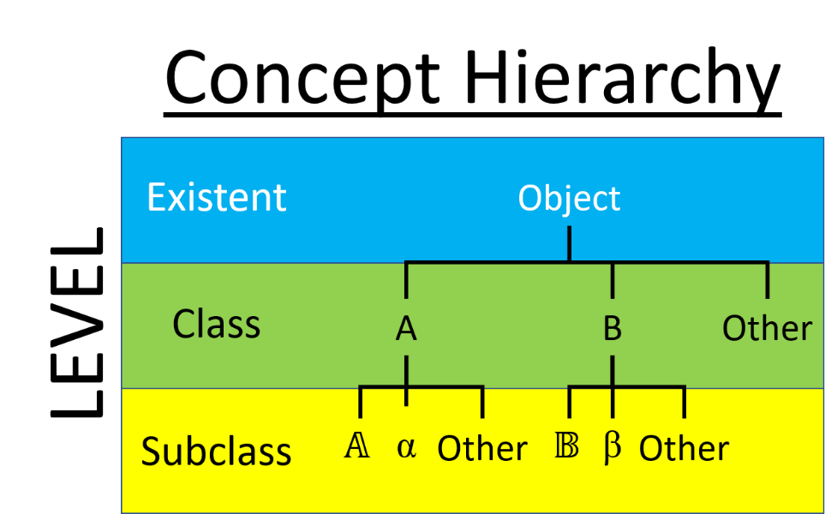



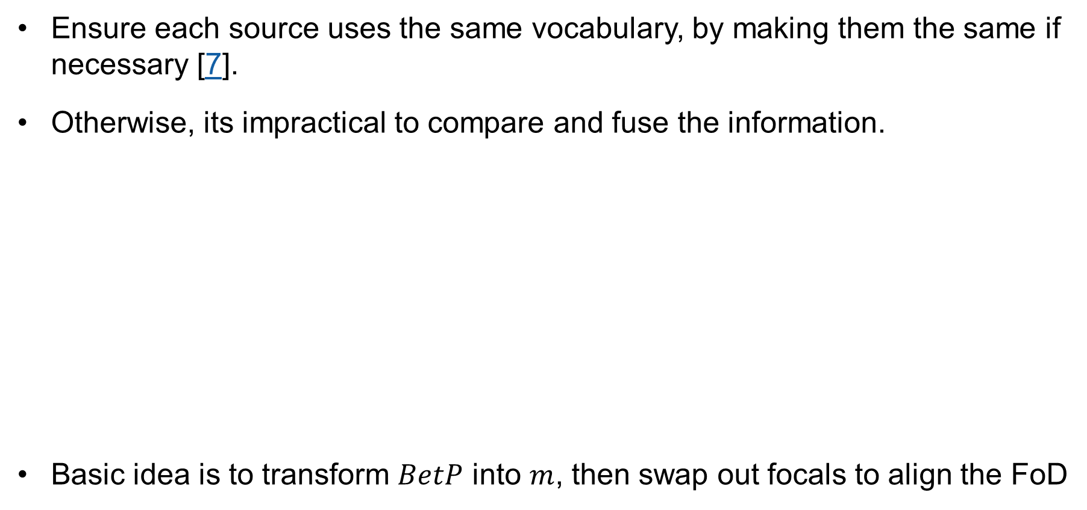











Pre-Fusion Processing: FoD Alignment
Ensure each source uses the same vocabulary, by making them the same if necessary [7].
Otherwise, its impractical to compare and fuse the information.
Basic idea is to transform $BetP$ into $m$, then swap out focals to align the FoD
Vocabulary 1
Vocabulary 2
$$Θ_{1}=\{θ_{1},θ_{2},θ_{3},θ_{4},θ_{5}\}$$
$$Θ_{2}=\{θ_{1a},θ_{1b},θ_{2},θ_{3},θ_{4a},θ_{4b},θ_{5}\}$$
$$θ_{4}$$
$$θ_{4b}$$
$$θ_{4a}$$
$$θ_{1a}$$
$$θ_{1}$$
$$θ_{1b}$$
$$θ_{5}$$
$$θ_{5}$$
$$θ_{3}$$
$$θ_{2}$$
$$θ_{3}$$
$$θ_{2}$$

Slide 21


Pre-Fusion Processing: FoD Alignment
Ensure each source uses the same vocabulary, by making them the same if necessary [7].
Otherwise, its impractical to compare and fuse the information.
Vocabulary 1
Vocabulary 2
Example:
$$Θ_{1}=\{θ_{1},θ_{2},θ_{3},θ_{4},θ_{5}\}$$
$$Θ_{2}=\{θ_{1a},θ_{1b},θ_{2},θ_{3},θ_{4a},θ_{4b},θ_{5}\}$$
    $m_{1}^{Θ_{2}}\left(θ_{1a}\right)=0.25$
    $m_{1}^{Θ_{2}}\left(θ_{1a}∪θ_{2}\right)=0.25$
    $m_{1}^{Θ_{2}} \left(θ_{1a}∪θ_{2}∪θ_{1b}\right)=0.25$
    $m_{1}^{Θ_{2}}\left(θ_{1a}∪θ_{2}∪θ_{1b}∪θ_{4b}\right)=0.25$
$$θ_{4}$$
$$θ_{4b}$$
$$θ_{4a}$$
$$θ_{1a}$$
$$θ_{1}$$
$$θ_{1b}$$
$$θ_{5}$$
$$θ_{5}$$
$$m_{1}^{Θ_{2}}⇒m_{1}^{Θ_{1}}$$
$$θ_{3}$$
$$θ_{2}$$
$$θ_{3}$$
$$θ_{2}$$
    $m_{1}^{Θ_{1}}\left(θ_{1}\right)=0.25$
    $m_{1}^{Θ_{1}}\left(θ_{1}∪θ_{2}\right)=0.5$
    $m_{1}^{Θ_{1}}\left(θ_{1}∪θ_{2}∪θ_{4}\right)=0.25$

Slide 22







Pre-Fusion Processing: Probability Calibration
There is a need to calibrate [7]:
  Overconfident sources (sources that provide a higher probability, in their max probable estimate, than is observed).
  Any existing tracking ambiguity.
Calibrating overconfidence, given a confusion matrix, $CM$, normalized to truth
  Normalize by column to create
  a power matrix, PM:
  Transform columns to $π$ via $PT_{C}^{−1}$ and CF
  Transform $BetP$ to $m$ via $PT_{C}^{−1}$
  Calculate calibrated $π$ for all $θ_{i}∈Θ$
  $$π_{CAL}\left(θ_{i}\right)=\sum_{X∈2^{Θ}}{m\left(X\right)\left(1−\prod_{\begin{aligned}X_{i}∈\left\{1..\left|Θ\right|\right\} \\ X_{i}∈X\end{aligned}}{\left(1−PM_{i,j}^{π}\right)}\right)}$$
Call*
Call*
$$PM$$
Normalize By Column
Truth
$$CM$$
$$\sum{row=1}$$
Truth
$$\sum{column=1}$$
Columns 2 $π$
Call*
$$PM^{π}$$
Truth
*Note: call is the highest probable predicted proposition

Slide 23



Pre-Fusion Processing: Probability Calibration
There is a need to calibrate [7]:
  Overconfident sources (sources that provide a higher probability, in their max probable estimate, than is observed).
  Any existing tracking ambiguity.
Calibrating overconfidence examples:
  $Θ=\left\{θ_{1},θ_{2},θ_{3}\right\}$
  $CM=\left[\begin{matrix}0.50 & 0.00 & 0.5 \\ 0.25 & 0.75 & 0.0 \\ 0.25 & 0.25 & 0.5\end{matrix}\right]$
  Example 1: $BetP=\left[1,0,0\right]⇒π_{CAL}=?$
  Example 2: $BetP=\left[0,1,0\right]⇒π_{CAL}=?$
  Example 3: $BetP=\left[0,0,1\right]⇒π_{CAL}=?$
  Normalize by column to create
  a power matrix, PM:
  Transform columns to $π$ via $PT_{C}^{−1}$ and CF
  Transform $BetP$ to $m$ via $PT_{C}^{−1}$
  Calculate calibrated $π$ for all $θ_{i}∈Θ$
  $$π_{CAL}\left(θ_{i}\right)=\sum_{X∈2^{Θ}}{m\left(X\right)\left(1−\prod_{\begin{aligned}X_{j}∈\left\{1..\left|Θ\right|\right\} \\ X_{j}∈X\end{aligned}}{\left(1−PM_{i,j}^{π}\right)}\right)}$$
Call*
$$CM$$
Truth
*Note: call is the highest probable predicted proposition
Notes:
$$PM=CM=\left[\begin{matrix}0.50 & 0.00 & 0.50 \\ 0.25 & 0.75 & 0.00 \\ 0.25 & 0.25 & 0.50\end{matrix}\right] \\ PM^{π}=\left[\begin{matrix}1.0 & 0.00 & 1.0 \\ 0.75 & 1.00 & 0.0 \\ 0.75 & 0.5 & 1.0\end{matrix}\right] \\ m_{1}\left(θ_{1}\right)=1⇒π_{CAL}=\left[1\left(1−\left(1−1.0\right)\right),1\left(1−\left(1−0.75\right)\right),1\left(1−\left(1−0.75\right)\right)\right]=\left[1.0,0.75,0.75\right] \\ m_{2}\left(θ_{2}\right)=1⇒π_{CAL}=\left[1\left(1−\left(1−0.0\right)\right),1\left(1−\left(1−1\right)\right),1\left(1−\left(1−0.5\right)\right)\right]=\left[0.0,1.0,0.5\right] \\ m_{3}\left(θ_{3}\right)=1⇒π_{CAL}=\left[1\left(1−\left(1−1.0\right)\right),1\left(1−\left(1−0.0\right)\right),1\left(1−\left(1−1.0\right)\right)\right]=\left[1.0,0.0,1.0\right]$$

Slide 24


Pre-Fusion Processing: Probability Calibration
There is a need to calibrate [7]:
  Overconfident sources (sources that provide a higher probability, in their max probable estimate, than is observed).
  Any existing tracking ambiguity.
Calibrating track ambiguity given a track-to-track
ambiguity matrix, $AM$
  for all $k∈\left\{1..N_{Tracks}\right\}$ and $A∈Θ$
  $${BetP}_{CAL,k}\left(A\right)=\sum_{t=\left\{1..N_{Tracks}\right\}}{{BetP}_{t}\left(A\right)AM_{k,t}}$$

Slide 25



Pre-Fusion Processing: Probability Calibration
There is a need to calibrate [7]:
  Overconfident sources (sources that provide a higher probability, in their max probable estimate, than is observed).
  Any existing tracking ambiguity.
Calibrating track ambiguity examples:
  $Θ=\left\{θ_{1},θ_{2},θ_{3}\right\}$
  $AM=\left[\begin{matrix}0.50 & 0.00 & 0.5 \\ 0.25 & 0.75 & 0.0 \\ 0.25 & 0.25 & 0.5\end{matrix}\right]$, i.e., 3 tracks
  ${BetP}_{1}=\left[0.5,0.25,0.25\right]⇒{BetP}_{CAL,1}=?$
  ${BetP}_{2}=\left[0.0,0.75,0.25\right]⇒{BetP}_{CAL,2}=?$
  ${BetP}_{3}=\left[0.5,0.0,0.5\right]⇒{BetP}_{CAL,3}=?$
  Calculate calibrated $m$ for all $k∈\left\{1..N_{Tracks}\right\}$ and $A∈Θ$
  $${BetP}_{CAL,k}\left(A\right)=\sum_{t=\left\{1..N_{Tracks}\right\}}{{BetP}_{t}\left(A\right)AM_{k,t}}$$
Expert Tracks
System Tracks
$$AM$$
Notes:
$m_{1}\left(θ_{1}\right)=0.25$, $m_{1}\left(θ_{1}∪θ_{2}∪θ_{3}\right)=0.75$
$m_{2}\left(θ_{2}\right)=0.5$, $m_{2}\left(θ_{2}∪θ_{3}\right)=0.5$
$$m_{3}\left(θ_{1}∪θ_{3}\right)=1.0$$
$$AM^{m}=AM=\left[\begin{matrix}0.50 & 0.00 & 0.5 \\ 0.25 & 0.75 & 0.0 \\ 0.25 & 0.25 & 0.5\end{matrix}\right]$$
$${BetP}_{CAL,1}={BetP}_{1}AM_{1,1}+{BetP}_{3}AM_{1,3}=\left[0.5 0.25 0.25\right]\left(0.5\right)+\left[0.5 0.0 0.5\right]\left(0.5\right)=\left[0.2500 0.1250 0.1250\right]+\left[0.25 0. 0 0.25\right]=\left[0.5000 0.1250 0.3750\right]$$
$${BetP}_{CAL,1}={BetP}_{1}AM_{2,1}+{BetP}_{2}AM_{2,2}=\left[0.5 0.25 0.25\right]\left(0.25\right)+\left[0.0 0.75 0.25\right]\left(0.75\right)=\left[0.1250 0.0625 0.0625\right]+\left[0 0.5625 0.1875\right]=\left[0.1250 0.6250 0.2500\right]$$
$${BetP}_{CAL,1}={BetP}_{1}AM_{3,1}+{BetP}_{2}AM_{3,2}+{BetP}_{3}AM_{3,3}=\left[0.5 0.25 0.25\right]\left(0.25\right)+\left[0.0 0.75 0.25\right]\left(0.25\right)+\left[0.5 0.0 0.5\right]\left(0.5\right)=\left[0.1250 0.0625 0.0625\right]+\left[0 0.1875 0.0625\right]+\left[0.25 0. 0 0.25\right]=\left[0.3750 0.2500 0.3750\right]$$

Slide 26





Pre-Fusion Processing: Review
Order of calibrating class or FoD Alignment
Removing Priors: $NL :BetP→ L$
FoD Alignment:
Probability Calibration: $PM^{π}$ & $AM^{m}$
$Θ_{D}$ is desired FoD
$Θ_{E}$ is expert’s FoD
$π^{Θ}$ is $PM^{π}$
At the end calibrate track ambiguity

Slide 27
Definitions
Transformations
Pre-Fusion Processing
Data Fusion
Post-Fusion Processing
Data Fusion:
Sequential Fusion
Simultaneous/Global Fusion
Dempster’s Rule
WCR Rule #1 & #2

Slide 28

Definitions: Sequential Fusion
In Shafer’s seminal text, A Mathematical Theory of Evidence [5], he conceived of a sequential fusion process represented geometrically by what he called a “square”, or what we might presently call matrix geometry.
This matrix geometry allows the combining of several sources of evidence sequentially by combining two sources (using matrix representation), then combining a third source with the result of the fusion of the two previous ones (still using matrix representation), and so on.

Slide 29

Definitions: Simultaneous/Global Fusion
Shafer also conceived of a simultaneous/global fusion process represented by what he called “n-dimensional geometry”, or what we presently call tensor geometry [5].
Both sequential and global fusion produces the same answer so long as the rule of combination is associative.

Slide 30











Definitions: Dempster’s Rule of Combination
Dempster’s rule (DR) forces $m\left(∅\right)=0$ and scales the rest of the BBMs by the normalizing factor $K_{12}$; and DR is undefined when $k_{12}=1$, which occurs when two (or more) experts are in total conflict.
$$m_{12}^{DR}\left(A\right)≡\left[m_{1}⊕m_{2}\right]\left(A\right)=K_{12}\sum_{\begin{aligned}X_{1},X_{2}∈2^{Θ} \\ X_{1}∩X_{2}=A≠∅\end{aligned}}{m_{1}\left(X_{1}\right)m_{2}\left(X_{2}\right)} \\ K_{12}=\frac{1}{1−k_{12}} \\ k_{12}=conflict=\sum_{\begin{aligned}X_{1},X_{2}∈2^{Θ} \\ X_{1}∩X_{2}=∅\end{aligned}}{m_{1}\left(X_{1}\right)m_{2}\left(X_{2}\right)}$$
For example, Let:
  $Θ=\left\{θ_{1},θ_{2} \right\}$
  $m_{1}\left(θ_{1}\right)=0.5$, $m_{1}\left(θ_{1}∪θ_{2}\right)=0.5$
  $m_{2}\left(θ_{2}\right)=0.5\text{, }m_{2}\left(θ_{1}∪θ_{2}\right)=0.5⇒m_{12}=?$
Matrix Representation
$$m_{1}\left(θ_{1}\right)$$
$$m_{1}\left(θ_{1}∪θ_{2}\right)$$
$$m_{1}$$
$$m_{1}\left(θ_{1}\right)m_{2}\left(θ_{2}\right)=k_{12}$$
$$θ_{1}∩θ_{2}=∅$$
$$m_{1}\left(θ_{1}∪θ_{2}\right)m_{2}\left(θ_{1}\right)$$
$$\left(θ_{1}∪θ_{2}\right)∩θ_{2}$$
$$m_{2}\left(θ_{2}\right)$$
$$m_{1}\left(θ_{1}\right)m_{2}\left(θ_{1}∪θ_{2}\right)$$
$$θ_{1}∩\left(θ_{1}∪θ_{2}\right)$$
$$m_{1}\left(θ_{1}∪θ_{2}\right)m_{2}\left(θ_{1}∪θ_{2}\right)$$
$$\left(θ_{1}∪θ_{2}\right)∩\left(θ_{1}∪θ_{2}\right)$$
$$m_{2}\left(θ_{1}∪θ_{2}\right)$$
$$m_{2}$$
Notes:
$$K_{12}=\frac{1}{1−0.25}=1\frac{1}{3} \\ m_{12}\left(θ_{1}\right)=K_{12}m_{1}\left(θ_{1}\right)m_{2}\left(θ_{1}∪θ_{2}\right)=\left(1\frac{1}{3}\right)\left(0.5\right)\left(0.5\right)=\frac{1}{3} \\ m_{12}\left(θ_{2}\right)=K_{12}m_{1}\left(θ_{1}∪θ_{2}\right)m_{2}\left(θ_{2}\right)=\left(1\frac{1}{3}\right)\left(0.5\right)\left(0.5\right)=\frac{1}{3} \\ m_{12}\left(θ_{1}∪θ_{2}\right)=K_{12}m_{1}\left(θ_{1}∪θ_{2}\right)m_{2}\left(θ_{1}∪θ_{2}\right)=\left(1\frac{1}{3}\right)\left(0.5\right)\left(0.5\right)=\frac{1}{3}$$

Slide 31

Data Fusion: WCR Rule #1 & #2
Weighted conflict redistribution (WCR) rules redistributes the fused mass amongst the root propositions [6].
Let $N$ be number of sources being fused, then for all $A∈2^{Θ}$:
$$m_{1..N}^{WCR}\left(A\right)=\sum_{\begin{aligned}X_{1},..,X_{N}∈2^{Θ} \\ A∈⊓_{i}X_{i}\end{aligned}}{w_{A}\prod_{i∈\left\{1,..,N\right\}}{m_{i}\left(X_{i}\right)}}$$
Rule #1:
$w_{A}=\left\{\begin{aligned}\begin{matrix}1 & for⊔_{i}X_{i}=⊓_{i}X_{i}\end{matrix} \\ \begin{matrix}\frac{γ_{A}^{γ_{A}}\left|A\right|}{\sum_{B∈⊓_{i}X_{i}}{\left(γ_{B}^{γ_{B}}\left|B\right|\right)}} & otherwise \end{matrix}\end{aligned}\right.$ $γ_{A}=\sum_{\begin{aligned}i∈\left\{1,..,N\right\} \\ NOT ⊔_{i}X_{i}⊆X_{i} \\ A⊆X_{i}\end{aligned}}{1}$
Rule #2:
$w_{A}=\left\{\begin{aligned}\begin{matrix}1 & for⊔_{i}X_{i}=⊓_{i}X_{i}\end{matrix} \\ \begin{matrix}\frac{β_{A}\left|A\right|}{\sum_{B∈⊓_{i}X_{i}}{β_{B}\left|B\right|}} & otherwise \end{matrix}\end{aligned}\right.$ $B_{A}=\sum_{\begin{aligned}i∈\left\{1,..,N\right\} \\ NOT ⊔_{i}X_{i}⊆X_{i} \\ A⊆X_{i}\end{aligned}}{m_{i}\left(X_{i}\right)}$

Slide 32




Data Fusion: WCR Rule #1 & #2
Weighted conflict redistribution (WCR) rules, modified Zadeh’s example (WCR0 is DR):
$Θ=\left\{M,T,C\right\}$
$m_{1}\left(M\right)=0.99$, $m_{1}\left(T\right)=0.01$
$m_{2}\left(C\right)=0.99$, $m_{2}\left(T\right)=0.01$
$m_{3}\left(C\right)=0.99$, $m_{3}\left(T\right)=0.01$
$w^{⊓_{i}X_{i}}$ notates the weights for the fusion method
corresponding to the elements in $⊓_{i}X_{i}$
$$BetP^{WCR0}=\left[0,0,1\right]$$
$BetP^{WCR1}=[0.20,0.01,0.79]$
$$BetP^{WCR2}=[0.33,0.00,0.67]$$

Slide 33

Data Fusion: Review
Sequential Fusion:
Simultaneous/Global Fusion:
Dempster’s Rule: $m_{12}^{DR}\left(A\right)=K_{12}\sum_{\begin{aligned}X_{1},X_{2}∈2^{Θ} \\ X_{1}∩X_{2}=A≠∅\end{aligned}}{m_{1}\left(X_{1}\right)m_{2}\left(X_{2}\right)}$
WCR Rule #1 & #2: $m_{1..N}^{WCR}\left(A\right)=\sum_{\begin{aligned}X_{1},..,X_{N}∈2^{Θ} \\ A∈⊓_{i}X_{i}\end{aligned}}{w_{A}\prod_{i∈\left\{1,..,N\right\}}{m_{i}\left(X_{i}\right)}}$

Slide 34
Definitions
Transformations
Pre-Fusion Processing
Data Fusion
Post-Fusion Processing
Post-Fusion Processing:
Pignistic Transform
Apply Prior

Slide 35
References
[1] P. Smets, R. Kennes, The Transferable Belief Model, Classic Works of the Dempster-Shafer Theory of Belief Functions:
Studies in Fuzziness and Soft Computing, pp. 693–736, 2008.
[2] P. Smets, The Transferable Belief Model For Quanitfied Belief Representation, Quantified Representation of Uncertainty and Imprecision, Springer, pp. 267–301, 1998.
[3] P. Smets, Decision Making in the TBM: the Necessity of the Pignistic Transformation, IJAR, vol. 38, no. 2, pp. 133–147, 2005.
[4] A. Aregui, T. Denoeux, Constructing Consonant Belief Functions from Sample Data Using Confidence Sets of Pignistic Probabilities, IJAR, vol. 49, no. 3, pp. 575–594, 2008.
[5] G. Shafer, A Mathematical Theory of Evidence, New Jersey: Princeton University Press, 1976
[6] D. Harris, J. Dezert, Investigating Another Weighted Conflict Redistribution Rule of Combination, 2023 Fusion Conference, Charleston, SC, 2023.
[7] D. Harris, D. Dunham, Addressing Assumptions About Expert Information Leveraging the Transferable Belief Model, 2021 IEEE Aerospace Conference, Big Sky, MT, 2021.

Slide 36
Dan Harris
Daniel.harris2@ngc.com

